Slide 1

Unit-1.2 Improper Integrals, Gamma Function & Beta Function
Mathematics-I (M-I)
GTU # 3110014
Prof. Darshan R. Pipaliya
Humanities & Science Department
darshan.pipaliya@darshan.ac.in
8160597689

Slide 2
OUTLINE
Method:6
Improper Integral of First Kind
Method:7
Improper Integral of Second Kind
Method:8
Convergence of Improper Integral of First Kind
Method:9
Convergence of Improper Integral of Second Kind
Method:10
Example on Gamma Function and Beta Function

Slide 3
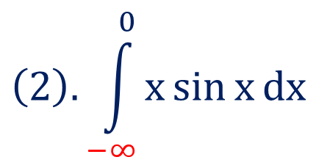
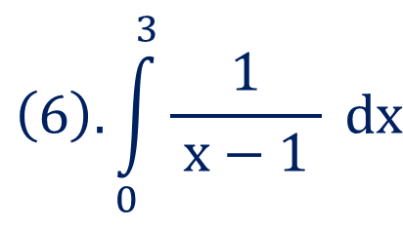
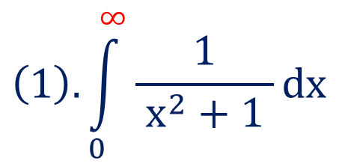
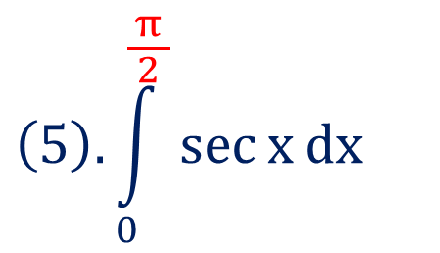
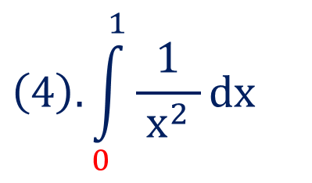
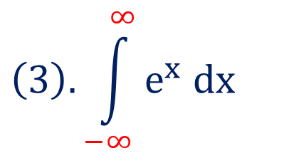
Improper Integral
If the limit of integral is infinite(one or both) or/and integrand function is
discontinuous for some value(s) on the interval of given integral then such
integral is known as an improper integral.
Examples
$$\left(1\right).\int_{0}^{∞}{\frac{1}{ x^{2}+1 }}dx$$
$$\left(2\right).\int_{−∞}^{0}{x\sin{x}dx}$$
$$\left(3\right).\int_{−∞}^{∞}{e^{x} dx}$$
$$\left(5\right).\int_{0}^{\frac{π}{ 2 }}{\sec{x}dx}$$
$$\left(4\right).\int_{0}^{1}{\frac{1}{ x^{2} }dx}$$
$$\left(6\right).\int_{0}^{3}{\frac{1}{ x−1 } dx}$$

Slide 4
Types of Improper Integral
There are three types of improper integrals
(1). Improper integral of first kind.
(2). Improper integral of second kind.
(3). Improper integral of third kind(combination of $1^{st} \& 2^{nd}$ kind).

Slide 5

Method:6
Improper Integral of First Kind

Slide 6
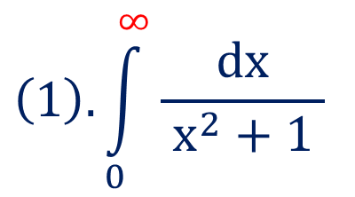
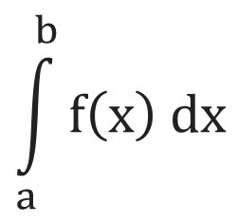
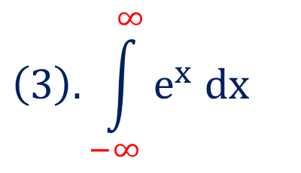
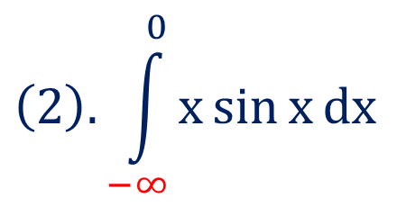
Improper Integral of First Kind
$$\int_{a}^{b}{f\left(x\right) dx}$$
For
either a or b or both(a & b) are infinite, then such integral is
known as an improper integral of first kind.
Examples
$$\left(1\right).\int_{0}^{∞}{\frac{dx}{ x^{2}+1 }}$$
$$\left(2\right).\int_{−∞}^{0}{x\sin{x}dx}$$
$$\left(3\right).\int_{−∞}^{∞}{e^{x} dx}$$

Slide 7
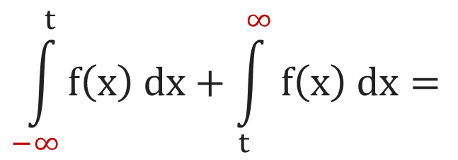
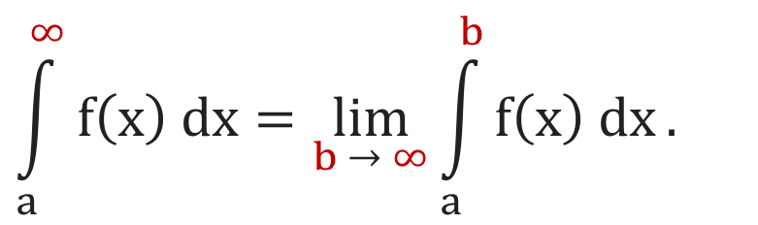
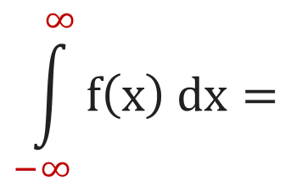


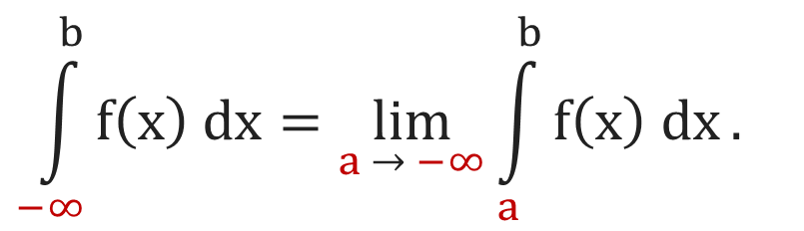

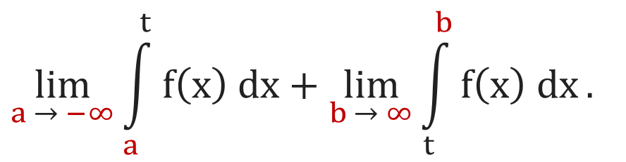
Sub-types of Improper Integral of First Kind
(1). If $f\left(x\right)$ is continuous on $\left[a, ∞\right)$ then
(2). If $f\left(x\right)$ is continuous on $\left(−∞, b\right]$ then
$$\int_{a}^{∞}{f\left(x\right) dx}=\lim_{b → ∞}{\int_{a}^{b}{f\left(x\right) dx}}.$$
$$\int_{−∞}^{b}{f\left(x\right) dx}=\lim_{a → −∞}{\int_{a}^{b}{f\left(x\right) dx}}.$$
(3). If $f\left(x\right)$ is continuous on $\left(−∞,∞\right)$ then
$$\int_{−∞}^{∞}{f\left(x\right) dx}=$$
$$\int_{−∞}^{t}{f\left(x\right) dx}+\int_{t}^{∞}{f\left(x\right) dx}=$$
$$\lim_{a → −∞}{\int_{a}^{t}{f\left(x\right) dx}}+\lim_{b → ∞}{\int_{t}^{b}{f\left(x\right) dx}}.$$

Slide 8
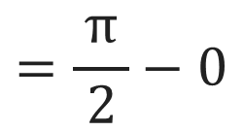
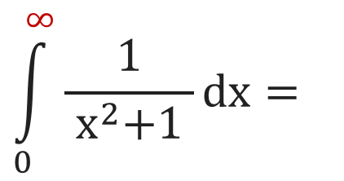
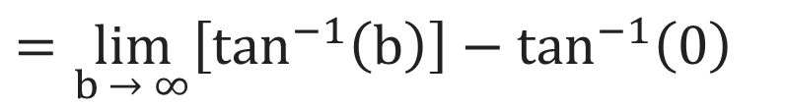
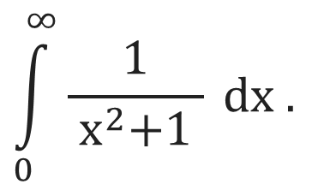
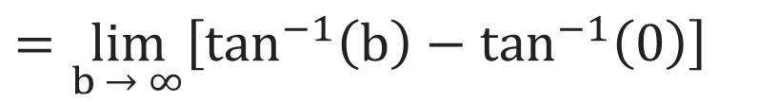
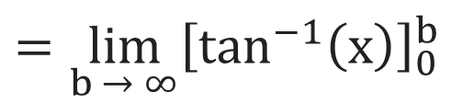
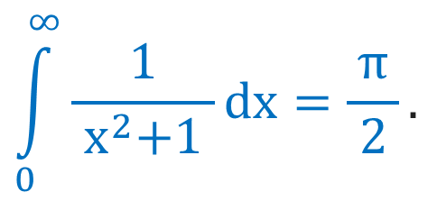
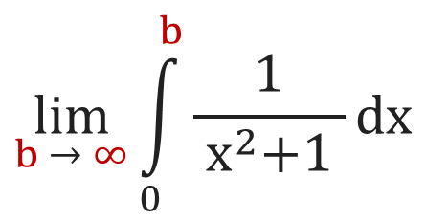
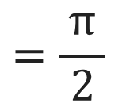
Improper Integral of First Kind
$$\int_{0}^{∞}{\frac{1}{{ x}^{2}+1 } dx .}$$
Example 1
Evaluate
$$\int_{0}^{∞}{\frac{1}{{ x}^{2}+1 }dx}=$$
$$\lim_{b → ∞}{\int_{0}^{b}{\frac{1}{{ x}^{2}+1 }dx}}$$
Solution:
$$=\lim_{b → ∞}{{\left[\tan^{−1}\left(x\right)\right]}_{0}^{b}}$$
$$=\lim_{b → ∞}\left[\tan^{−1}\left(b\right)−\tan^{−1}\left(0\right)\right]$$
$$=\lim_{b → ∞}\left[\tan^{−1}\left(b\right)\right]−\tan^{−1}\left(0\right)$$
$$=\frac{π}{ 2 }−0$$
$$=\frac{π}{ 2 }$$
$$\int_{0}^{∞}{\frac{1}{{ x}^{2}+1 }dx}=\frac{π}{ 2 }.$$
Hence,

Slide 9
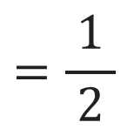
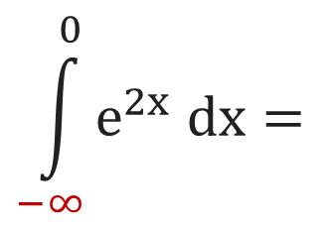
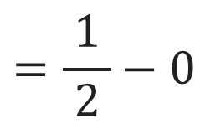
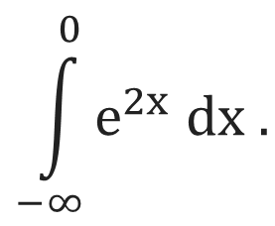
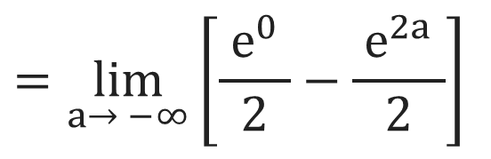
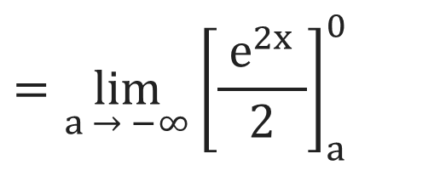
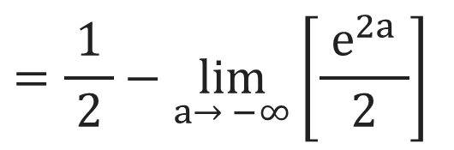
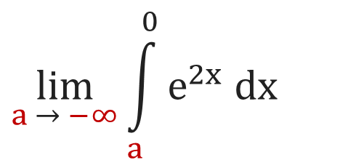
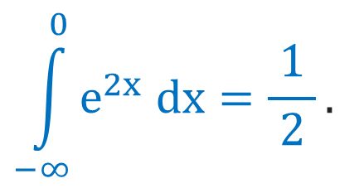
Improper Integral of First Kind
$$\int_{−∞}^{0}{e^{2x} dx .}$$
Example 5
Evaluate
$$\int_{−∞}^{0}{e^{2x} dx}=$$
$$\lim_{a → −∞}{\int_{a}^{0}{e^{2x} dx}}$$
$$=\lim_{a → −∞}{{\left[\frac{{ e}^{2x} }{2}\right]}_{a}^{0}}$$
Solution:
$$=\lim_{a→ −∞}\left[\frac{{ e}^{0} }{2}−\frac{{ e}^{2a} }{2}\right]$$
$$=\frac{ 1 }{2}−\lim_{a→ −∞}\left[\frac{{ e}^{2a} }{2}\right]$$
$$=\frac{1}{ 2 }−0$$
$$=\frac{1}{ 2 }$$
$$\int_{−∞}^{0}{e^{2x} dx}=\frac{1}{ 2 }.$$
Hence,

Slide 10
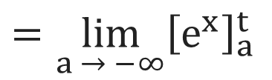
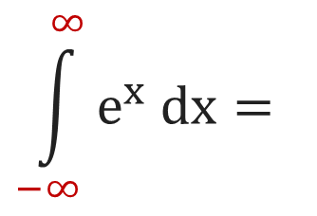
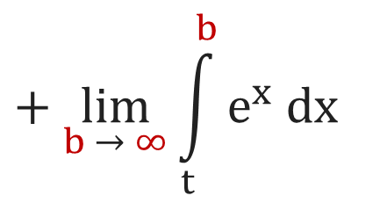
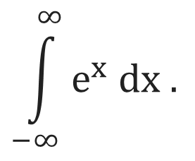
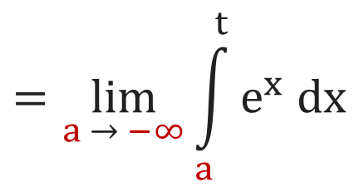
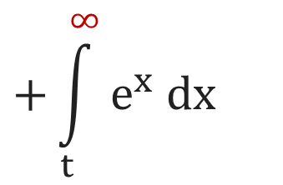
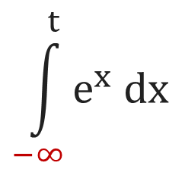
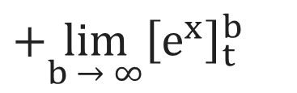
Improper Integral of First Kind
$$\int_{−∞}^{∞}{e^{x} dx .}$$
Example 9
Evaluate
$$\int_{−∞}^{∞}{e^{x} dx}=$$
$$\int_{−∞}^{t}{e^{x} dx}$$
$$+\int_{t}^{∞}{e^{x} dx}$$
Solution:
$$=\lim_{a → −∞}{\int_{a}^{t}{e^{x} dx}}$$
$$+ \lim_{b → ∞}{\int_{t}^{b}{e^{x} dx}}$$
$$=\lim_{a → −∞}{{\left[e^{x}\right]}_{a}^{t}}$$
$$+\lim_{b → ∞}{{\left[e^{x}\right]}_{t}^{b}}$$

Slide 11
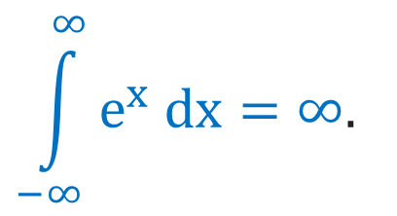
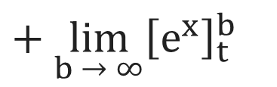


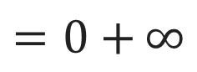
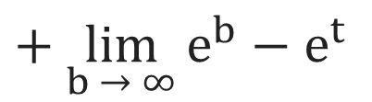
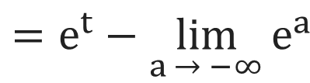
Improper Integral of First Kind
Solution Continue
$$\lim_{a → −∞}{{\left[e^{x}\right]}_{a}^{t}}$$
$$+ \lim_{b → ∞}{{\left[e^{x}\right]}_{t}^{b}}$$
$$=e^{t}−\lim_{a → −∞}{e^{a}}$$
$$+ \lim_{b → ∞}{e^{b}}−e^{t}$$
$$=0+{∞}$$
$$=∞$$
$$\int_{−∞}^{∞}{e^{x} dx}=∞.$$
Hence,

Slide 12
Method:7
Improper Integral of Second Kind

Slide 13
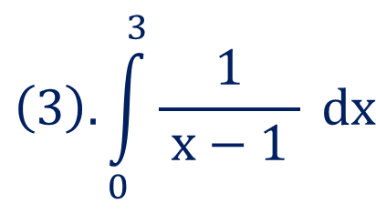
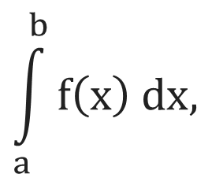
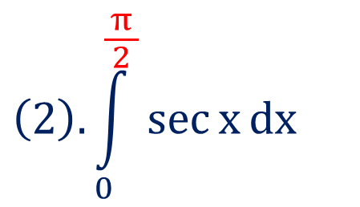
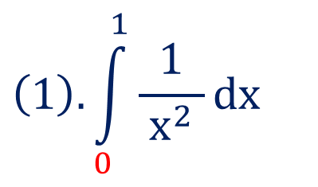
Improper Integral of Second Kind
$$\int_{a}^{b}{f\left(x\right) dx,}$$
For
$f\left(x\right)$ become discontinuous at $x=a$ or $x=b$ or at finite number
of points in the interval $\left(a, b\right),$ then such an integral is known as improper
integral of second kind.
Examples
$$\left(2\right).\int_{0}^{\frac{π}{ 2 }}{\sec{x}dx}$$
$$\left(1\right).\int_{0}^{1}{\frac{1}{ x^{2} }dx}$$
$$\left(3\right).\int_{0}^{3}{\frac{1}{ x−1 } dx}$$

Slide 14









Sub-types of Improper Integral of Second Kind
(1). If $x=a$ is the point of discontinuity
(2). If $x=b$ is the point of discontinuity
for $f\left(x\right)$ then
for $f\left(x\right)$ then
$$\int_{a}^{b}{f\left(x\right) dx}=\lim_{t → a}{\int_{t}^{b}{f\left(x\right) dx}}.$$
$$\int_{a}^{b}{f\left(x\right) dx}=\lim_{t → b}{\int_{a}^{t}{f\left(x\right) dx}}.$$
(3). If $x=c∈\left(a, b\right)$ is the point of discontinuity for $f\left(x\right)$ then
$$\int_{a}^{b}{f\left(x\right) dx}=$$
$$\int_{a}^{c}{f\left(x\right) dx}+\int_{c}^{b}{f\left(x\right) dx}$$
$$=\lim_{t → c}{\int_{a}^{t}{f\left(x\right) dx}}+\lim_{t → c}{\int_{t}^{b}{f\left(x\right) dx}}.$$

Slide 15








Improper Integral of Second Kind
$$\int_{0}^{3}{\frac{1}{ {\left(x−1\right)}^{\frac{2}{ 3 }} } dx .}$$
Example 9
Evaluate
$$\int_{0}^{3}{\frac{1}{ {\left(x−1\right)}^{\frac{2}{ 3 }} } dx}=$$
$$\int_{0}^{1}{\frac{1}{ {\left(x−1\right)}^{\frac{2}{ 3 }} }dx}$$
$$+\int_{1}^{3}{\frac{1}{ {\left(x−1\right)}^{\frac{2}{ 3 }} }dx}$$
Solution:
$$=\lim_{t → 1}{\int_{0}^{t}{{\left(x−1\right)}^{− \frac{2}{ 3 }} dx}}$$
$$+ \lim_{t → 1}{\int_{t}^{3}{{\left(x−1\right)}^{− \frac{2}{ 3 }} dx}}$$
$$=\lim_{t → 1}{{\left[\frac{{ \left(x−1\right)}^{\frac{1}{ 3 }} }{\frac{1}{ 3 }}\right]}_{0}^{t}}$$
$$+ \lim_{t → 1}{{\left[\frac{{ \left(x−1\right)}^{\frac{1}{ 3 }} }{\frac{1}{ 3 }}\right]}_{t}^{3}}$$

Slide 16








Improper Integral of Second Kind
$$\lim_{t → 1}{{\left[{3\left(x−1\right)}^{\frac{1}{ 3 }}\right]}_{0}^{t}}$$
$$+ \lim_{t → 1}{{\left[{3\left(x−1\right)}^{\frac{1}{ 3 }}\right]}_{t}^{3}}$$
Solution Continue
$$=\lim_{t → 1}\left[{3\left(t−1\right)}^{\frac{1}{ 3 }}\right]−3{\left(−1\right)}^{\frac{1}{ 3 }}$$
$$+ 3{\left(2\right)}^{\frac{1}{ 3 }}−\lim_{t → 1}\left[{3\left(t−1\right)}^{\frac{1}{ 3 }}\right]$$
$$=0−3{\left(−1\right)}^{\frac{1}{ 3 }}$$
$$+ 3{\left(2\right)}^{\frac{1}{ 3 }}−0$$
$$= 3\left[{\left(2\right)}^{\frac{1}{ 3 }}−{\left(−1\right)}^{\frac{1}{ 3 }}\right]$$
$$\int_{0}^{3}{\frac{1}{ {\left(x−1\right)}^{\frac{2}{ 3 }}} dx}=3\left[{\left(2\right)}^{\frac{1}{ 3 }}−{\left(−1\right)}^{\frac{1}{ 3 }}\right].$$
Hence,

Slide 17
Convergence or Divergence of Improper Integral
If integral has finite value then we can say that given integral is convergent.
If integral has infinite value then we can say that given integral is divergent.

Slide 18
Method:8
Convergence of Improper Integral of First Kind

Slide 19






Convergence of Improper Integral of First Kind
$$\int_{5}^{∞}{\frac{5x}{ {\left(1+x^{2}\right)}^{3} } dx .}$$
Example 8
Investigate the convergence of
$$\int_{5}^{∞}{\frac{5x}{ {\left(1+x^{2}\right)}^{3} } dx}$$
$$=\frac{5}{ 2 }\int_{5}^{∞}{\left(2x\right){\left(1+x^{2}\right)}^{−3}dx}$$
Solution:
$$=\frac{5}{ 2 }\lim_{b → ∞}\int_{5}^{b}{{\left(1+x^{2}\right)}^{−3}\left(2x\right) dx}$$
$$=\frac{5}{ 2 }\lim_{b → ∞}{\left[\frac{{ \left(1+x^{2}\right)}^{−2} }{−2}\right]}_{5}^{b}$$
$\int{{\left[f(x)\right]}^{n}f^{′}\left(x\right)dx=\frac{ {\left[f\left(x\right)\right]}^{n+1} }{n+1}}+c$

Slide 20






Convergence of Improper Integral of First Kind
$$− \frac{5}{ 4 }\lim_{b → ∞}{\left[\frac{1}{{\left(1+x^{2}\right)}^{2}}\right]}_{5}^{b}$$
Solution Continue
$$=− \frac{5}{ 4 }\left[\lim_{b → ∞}\frac{1}{{\left(1+b^{2}\right)}^{2}}\right]$$
$$+\frac{5}{ 4 }\left[\frac{1}{ {\left(1+{\left(5\right)}^{2}\right)}^{2} }\right]$$
$$=0+\frac{5}{ 4 }\left[\frac{1}{ {\left(26\right)}^{2} }\right]$$
$$=\frac{5}{ 2704 }$$
Which is finite.
$$\int_{5}^{∞}{\frac{5x}{ {\left(1+x^{2}\right)}^{3} } dx}$$
Hence,
is convergent.

Slide 21




P-integral Test
$$\int_{a}^{∞}{\frac{1}{{ x}^{p} } dx}$$
is convergent if $p>1$ & divergent if $p≤1$.
$$\int_{0}^{a}{\frac{1}{{ x}^{p} } dx}$$
is convergent if $p<1$ & divergent if $p≥1$.

Slide 22




Direct Comparison Test
If $f\left(x\right)$ and $g\left(x\right)$ are continuous on $\left[a, ∞\right)$ and $0≤f\left(x\right)≤g\left(x\right)$ for all $x≥a$ then
$$\int_{a}^{∞}{g\left(x\right) dx}$$
$$\int_{a}^{∞}{f\left(x\right) dx}$$
(1). If
is convergent then
is convergent.
$$\int_{a}^{∞}{f\left(x\right) dx}$$
$$\int_{a}^{∞}{g\left(x\right) dx}$$
(2). If
is divergent then
is divergent.

Slide 23






Convergence of Improper Integral of First Kind
$$\int_{1}^{∞}{\frac{\sin^{2}{x} }{x^{2}} dx .}$$
Example 5(1)
Check the convergence of
Solution:
We know that
$$−1≤\sin{x}≤1$$
$$⇒0≤\sin^{2}{x}≤1$$
$$⇒0≤\frac{\sin^{2}{x} }{x^{2}}≤\frac{1}{{ x}^{2} }, ∀x∈\left[1, ∞\right)$$
$$\int_{1}^{∞}{\frac{1}{ x^{2} } dx}$$
We know that
is convergent by p-integral test.

Slide 24


Convergence of Improper Integral of First Kind
Solution Continue
$$\int_{1}^{∞}{\frac{\sin^{2}{x }}{x^{2}} dx}$$
Hence, by direct comparison test
is convergent.

Slide 25










Limit Comparison Test
$$L=\lim_{x → ∞}{\frac{f\left(x\right)}{ g\left(x\right) }}$$
If $f\left(x\right)$ and $g\left(x\right)$ are positive and continuous on $\left[a, ∞\right)$ and
then
$$\int_{a}^{∞}{f\left(x\right) dx}$$
$$\int_{a}^{∞}{g\left(x\right) dx}$$
$(1).$If $0<L<∞$ then
and
both are convergent or divergent
together.
$$\int_{a}^{∞}{g\left(x\right) dx}$$
$$\int_{a}^{∞}{f\left(x\right) dx}$$
$(2).$If $L=0$ and
is convergent then
is convergent.
$$\int_{a}^{∞}{g\left(x\right) dx}$$
$$\int_{a}^{∞}{f\left(x\right) dx}$$
$(3).$If $L=∞$ and
is divergent then
is divergent.

Slide 26







Convergence of Improper Integral of First Kind
$$\int_{4}^{∞}{\frac{ 3x+5 }{ x^{4}+7 } dx .}$$
Example 10
Check the convergence of
$$\int_{4}^{∞}{\frac{ 3x+5 }{ x^{4}+7 } dx}$$
$$=\int_{4}^{∞}{f\left(x\right) dx}$$
Solution:
Let
$$g\left(x\right)=\frac{x}{{ x}^{4} }=\frac{1}{ x^{3} }$$
Consider
$$=\lim_{x → ∞}{\frac{ \frac{ 3x+5 }{ x^{4}+7 } }{\frac{1}{ x^{3} }}}$$
$$L=\lim_{x → ∞}{\frac{f\left(x\right)}{ g\left(x\right) }}$$
$$=\lim_{x → ∞}{\frac{ \left(x^{3}\right)\left(3x+5\right) }{ x^{4}+7 }}$$
Now,

Slide 27






Convergence of Improper Integral of First Kind
$$\lim_{x → ∞}{\frac{ \left(x^{3}\right)\left(3x+5\right) }{ x^{4}+7 }}$$
Solution Continue
$$=\lim_{x → ∞} \frac{ x^{4}\left(3+\frac{5}{ x }\right) }{ x^{4}\left(1+\frac{7}{ x^{4} }\right) }$$
$$=\lim_{x → ∞} \frac{ \left(3+\frac{5}{ x }\right) }{ \left(1+\frac{7}{ x^{4} }\right) }$$
$$=3$$
$$⇒0<L=3<∞$$
$$\int_{4}^{∞}{\frac{1}{ x^{3} } dx}$$
We know that
is convergent by p-integral test.

Slide 28

Convergence of Improper Integral of First Kind
Solution Continue
$$\int_{4}^{∞}{\frac{ 3x+5 }{ x^{4}+7 } dx}$$
Hence, by limit comparison test
is convergent.

Slide 29
Method:9
Convergence of Improper Integral of Second Kind

Slide 30


Convergence of Improper Integral of Second Kind
Example 5
Define improper integral of both the kinds and check the convergence of
$$\int_{0}^{3}{\frac{dx}{\sqrt{9−x^{2} }}.}$$
Solution:

Slide 31




Convergence of Improper Integral of Second Kind
Solution Continue
$$\int_{0}^{3}{\frac{dx}{\sqrt{9−x^{2} }}}$$
$$=\lim_{b → 3}\int_{0}^{b}{\frac{dx}{\sqrt{9−x^{2} }}}$$
$$=\lim_{b → 3}{\left[\sin^{−1}\left(\frac{x}{ 3 }\right)\right]}_{0}^{b}$$

Slide 32






Convergence of Improper Integral of Second Kind
$$\lim_{b → 3}{\left[\sin^{−1}\left(\frac{x}{ 3 }\right)\right]}_{0}^{b}$$
Solution Continue
$$=\lim_{b → 3}\sin^{−1}\left(\frac{b}{ 3 }\right)−\sin^{−1}\left(0\right)$$
$$=\frac{π}{ 2 }−0$$
$$=\sin^{−1}\left(1\right)−\sin^{−1}\left(0\right)$$
$$=\frac{π}{ 2 }$$
Which is finite.
$$\int_{0}^{3}{\frac{dx}{\sqrt{9−x^{2} }}}$$
Hence,
is convergent.

Slide 33



Gamma Function
$$\int_{0}^{∞}{e^{−x}x^{n−1} dx}$$
If $n>0,$ then Gamma function is defined by the integral
$$Γ\left(n\right)=\int_{0}^{∞}{e^{−x}x^{n−1} dx}.$$
and it is denoted by $Γ(n)$. i.e.

Slide 34







Properties of Gamma Function
$(1).$Reduction formula for Gamma function is $Γ\left(n+1\right)=Γ\left(n\right);$ where$n>0.$
$(2).$If n is positive integer, then $Γ\left(n+1\right)=n!.$
$$\int_{0}^{∞}{e^{−x^{2}}x^{2m−1} dx}=\frac{1}{ 2 }Γ\left(n\right).$$
$(3).$Second form of Gamma function is
$$\left(4\right). Γ\left(n+\frac{1}{ 2 }\right)=\frac{ \left(2n\right)!\sqrt{π } }{n!4^{n}} for n=0, 1, 2, 3, ….$$
$$For n=0, Γ\left(\frac{1}{ 2 }\right)=\sqrt{π }$$
$$For n=1, Γ\left(\frac{3}{ 2 }\right)=\frac{ \sqrt{π } }{2}$$
$$For n=2, Γ\left(\frac{5}{ 2 }\right)=\frac{ 3\sqrt{π } }{4}$$

Slide 35



Beta Function
If $m>0,n>0,$ then Beta function is defined by the integral
$$\int_{0}^{1}{x^{m−1}{\left(1−x\right)}^{n−1} dx}$$
and it is denoted by $β\left(m, n\right) or Β\left(m, n\right)$.
$$β\left(m, n\right)=\int_{0}^{1}{x^{m−1}{\left(1−x\right)}^{n−1} dx}.$$
i.e.

Slide 36



Properties of Beta Function
$(1).$Beta function is a symmetric function. i.e. $β\left(m, n\right)=β\left(n, m\right), where m, n>0.$
$$(2).β\left(m, n\right)=2\int_{0}^{\frac{π}{ 2 }}{\sin^{2m−1}θ\cos^{2n−1}θ dθ.}$$
$$(3).\int_{0}^{\frac{π}{ 2 }}{\sin^{p}θ\cos^{q}θ dθ=\frac{1}{ 2 }β\left(\frac{ p+1 }{2},\frac{ q+1 }{2}\right).}$$
$$\left(4\right). β\left(m, n\right)=\int_{0}^{∞}{\frac{x^{m−1}}{ {\left(1+x\right)}^{m+n} } dx}.$$

Slide 37


Properties of Beta Function
$$β\left(m, n\right)=\frac{ Γ\left(m\right)Γ\left(n\right) }{Γ\left(m+n\right)}.$$
$(5).$Relation between Beta and Gamma function,

Slide 38


Example on Gamma Function and Beta Function
$$\int_{0}^{∞}{e^{−x^{2}}dx .}$$
Example 2
Define Gamma function and evaluate
Solution

Slide 39










Example on Gamma Function and Beta Function
$$\int_{0}^{∞}{e^{−x^{2}}dx }$$
Solution Continue
Consider
$$x^{2}=t⇒x=\sqrt{t }$$
$$⇒dx=\frac{dt}{ 2x }$$
$$=\frac{dt}{ 2\sqrt{t } }$$
$$⇒2x dx=dt$$
Now
$$x→0⇒t→0$$
$$\& x→∞⇒t→∞$$
$$⇒\int_{0}^{∞}{e^{−x^{2}}dx }$$
$$=\int_{0}^{∞}{\frac{e^{−t}dt}{2\sqrt{t } } }$$
$$=\frac{1}{ 2 }\int_{0}^{∞}{e^{−t} t^{− \frac{1}{ 2 }}dt}$$

Slide 40





Example on Gamma Function and Beta Function
$$\frac{1}{ 2 }\int_{0}^{∞}{e^{−t} t^{\frac{1}{ 2 } −1}dt}$$
Solution Continue
$$\left(∵Γ\left(n\right)=\int_{0}^{∞}{e^{−x}x^{n−1} dx}\right)$$
$$=\frac{1}{ 2 }Γ\left(\frac{1}{ 2 }\right)$$
$$=\frac{ \sqrt{π } }{2}$$
$$\int_{0}^{∞}{e^{−x^{2}}dx }=\frac{ \sqrt{π } }{2}.$$
Hence,

Slide 41






Example on Gamma Function and Beta Function
$$β\left(\frac{7}{ 2 },\frac{5}{ 2 }\right).$$
Example 8
Find
$$β\left(m, n\right)=\frac{ Γ\left(m\right)Γ\left(n\right) }{Γ\left(m+n\right)}.$$
Solution
We know that
$$= \frac{ Γ\left(\frac{7}{ 2 }\right)Γ\left(\frac{5}{ 2 }\right) }{Γ\left(\frac{7}{ 2 }+\frac{5}{ 2 }\right)}$$
$$= \frac{ Γ\left(\frac{7}{ 2 }\right)Γ\left(\frac{5}{ 2 }\right) }{Γ\left(6\right)}$$
$$⇒β\left(\frac{7}{ 2 },\frac{5}{ 2 }\right)$$
$$=\frac{ \left(\frac{5}{ 2 }∙\frac{3}{ 2 }∙\frac{1}{ 2 }∙\sqrt{π }\right)\left(\frac{3}{ 2 }∙\frac{1}{ 2 }∙\sqrt{π }\right) }{\left(5\right)!}$$

Slide 42



Example on Gamma Function and Beta Function
$$=\frac{ 45π }{ 32\left(120\right) }$$
Solution Continue
$$=\frac{ 3π }{ 256 }$$
$$β\left(\frac{7}{ 2 },\frac{5}{ 2 }\right)=\frac{ 3π }{ 256 }.$$
Hence,

Slide 43
Mathematics-I (M-I)
GTU # 3110014
THANK YOU
Prof. Darshan R. Pipaliya
Humanities & Science Department
darshan.pipaliya@darshan.ac.in
918160597689

